Slide 1



Biz Tech Analytics SQL Assignment From Hacker Rank
MD Danish

Slide 2

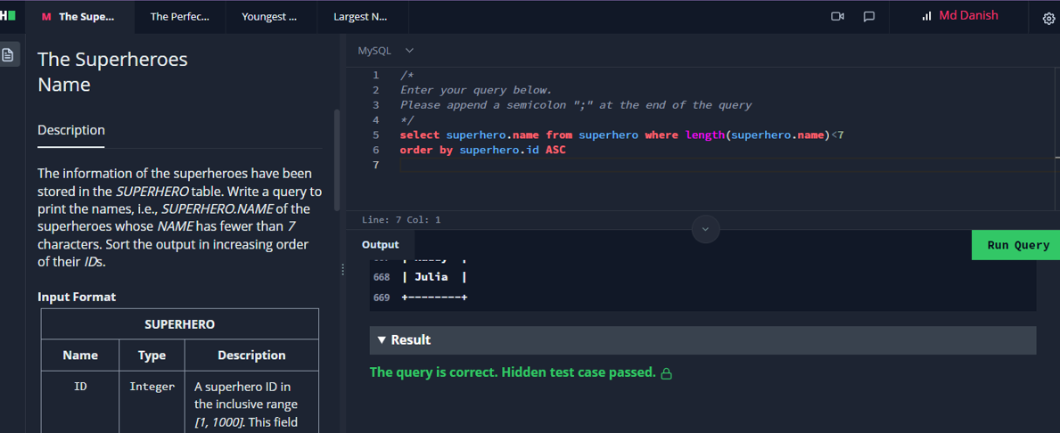

select superhero.name from superhero where length(superhero.name)<7 order by superhero.id ASC;
This query will first select all rows from the SUPERHERO table where the length of the NAME column is less than 7.
This will filter out all superheroes whose names have more than 6 characters.
The results will then be sorted in increasing order by the ID column.
This will ensure that the superheroes with the smallest IDs are displayed first.

Slide 3
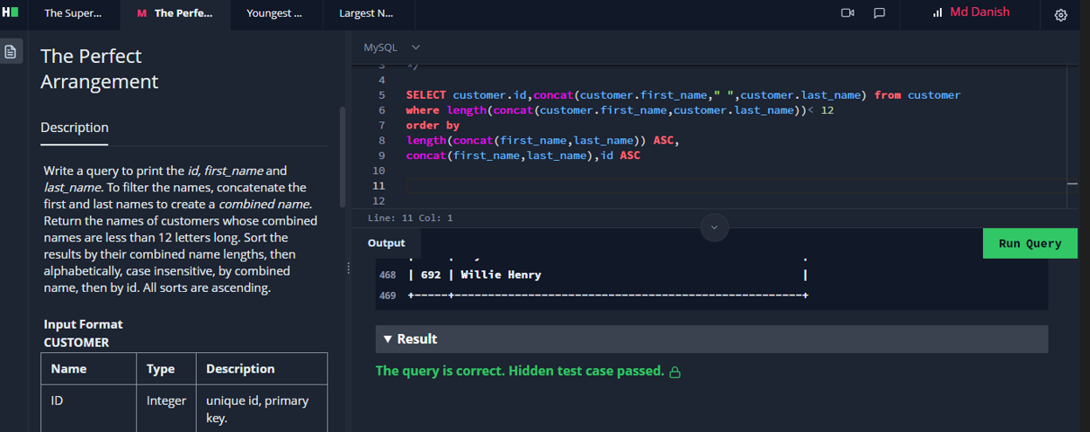
SELECT customer.id,concat(customer.first_name," ",customer.last_name) from customer where length(concat(customer.first_name,customer.last_name))< 12 order by length(concat(first_name,last_name)) ASC, concat(first_name,last_name),id asc;
This MySQL query retrieves the id and the full name of customers from the customer table. The query first filters the customers based on the combined length
And their first and last names, selecting only those with a combined length less than 12 characters. It then orders the results based
on the length of the concatenated first and
last names in ascending order, followed by the full name in ascending order, and finally the customer ID in ascending orders.

Slide 4
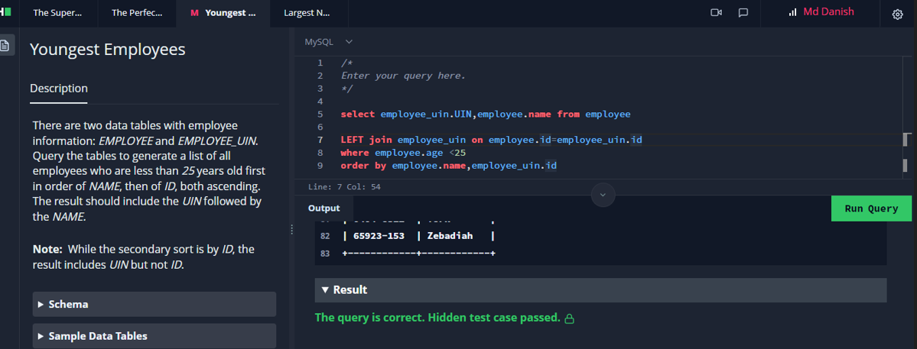
select employee_uin.UIN,employee.name from employee LEFT join employee_uin on employee.id=employee_uin.id where employee.age <25 order by employee.name,employee_uin.id
This SQL query retrieves the UIN and name of employees from the employee table. It uses a LEFT JOIN to combine
the employee table with the employee_uin table based on the id column. The query filters the employees based on the condition that their age is less than 25.
The final result
set is then ordered by the employee name from the employee table and the id from the employee_uin table.

Slide 5
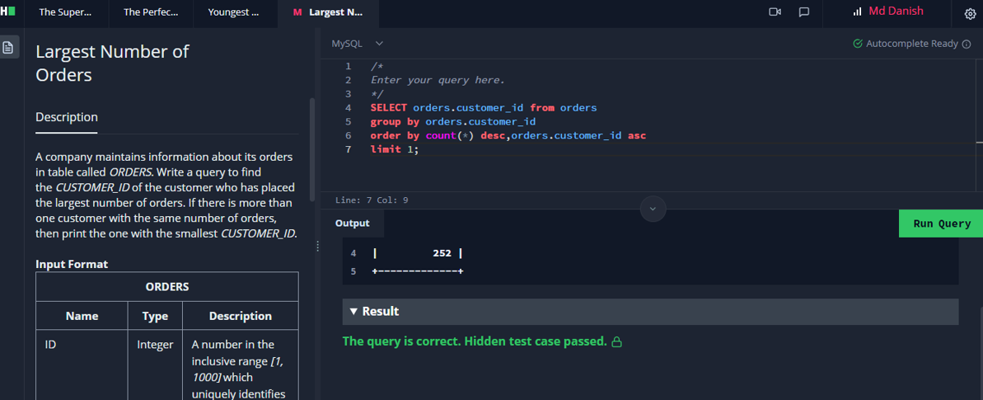
SELECT orders.customer_id from orders group by orders.customer_id order by count(*) desc,orders.customer_id asc limit 1;
This query essentially retrieves the customer_id of the customer with the most orders, as it groups the orders by
customer and then orders the groups by the count of
orders in descending order. The LIMIT 1 clause ensures that only the record with the highest count is returned.

